Slide 1










Mapping inequality in access to resources in R
Andy Nelson (ITC, U. Twente), Jacob van Etten (Bioversity International), Daniel Weiss (U. Oxford)
a.nelson@utwente.nl
@Dr_Andy_Nelson
research.utwente.nl/en/persons/andy-nelson
Notes:
More equal access to the resources that sustain human well-being, such as education, employment and health services, underpins the equality agenda of 'leaving no one behind' established by the Sustainable Development Goals of the United Nations. Accessibility can be defined as the ability to interact with locations that offer economic and social opportunities; better access usually means better opportunities and better livelihood outcomes. The accessibility of a particular location can be quantified in several ways: equity (i.e. proximity based on distance or travel time); coverage (i.e. the number of reachable resources per person), or; integration (i.e. the likelihood of interactions or the cost of transactions). Spatial modelling of accessibility uses the geographic location of the population in relation to target locations and the transport means and infrastructure to access those locations. This presentation discusses (i) recent work on mapping equity in access in R using the gdistance package, (ii) options for mapping other access indicators in R and (iii) the importance of good, up to date and easy to use transport network data for accessibility mapping.

Slide 2
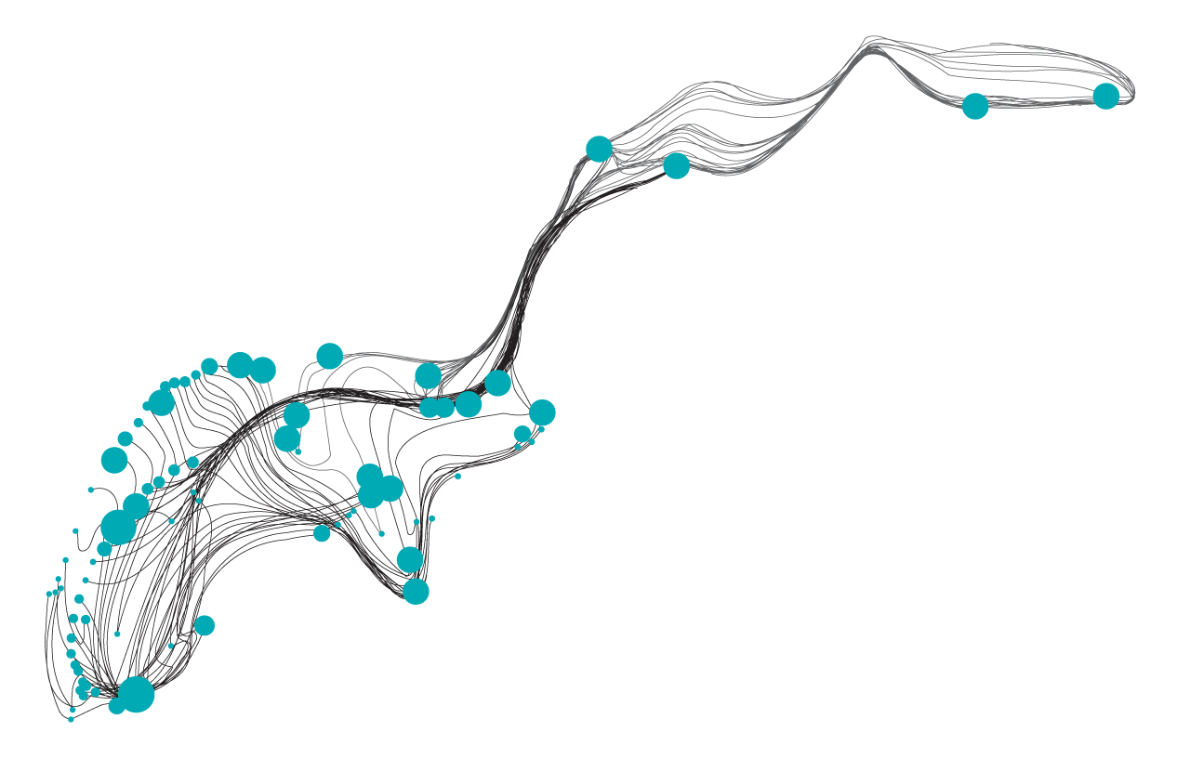
Outline
Access and accessibility: relevance for development
Mapping access in years 2000 and 2015 (From ArcGIS to GEE to R)
Where next – what is needed to map different measures of access in R
Notes:
The slot is 30 mins, so I can talk for about 20mins.

Slide 3
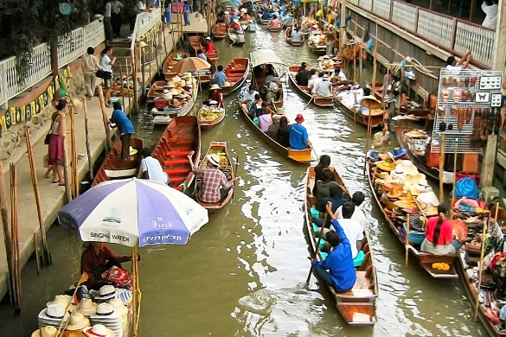
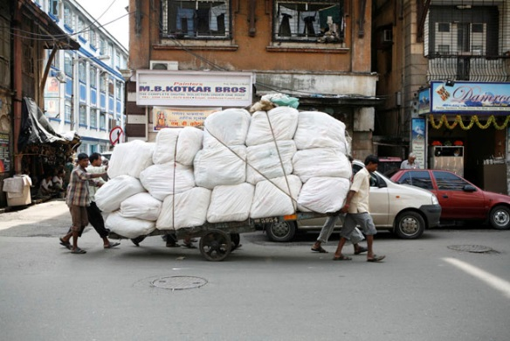
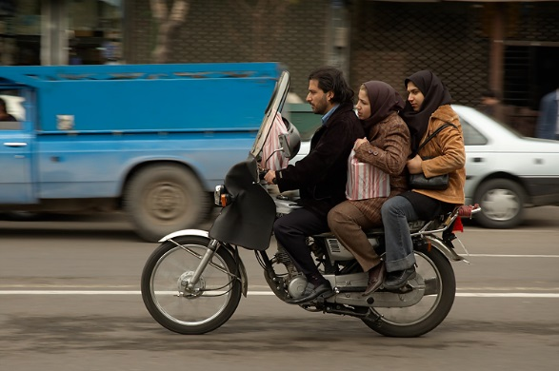
Mobility, policy and opportunity
43m km² - around 1000 times the size of the Netherlands
Accessibility is related to the mobility of people, goods & information. The choices people make & the options people have are important policy making considerations.
Accessibility is linked to social and economic opportunity, but it is often misunderstood, poorly defined or poorly measured^{[1,2]}.
1 Geurs, K. T. & Ritsema van Eck, J. Accessibility measures: review and applications. Evaluation of accessibility impacts of land-use transportation scenarios, and related social and economic impact. RIVM Report (2001).
2 Geurs, K. T. & van Wee, B. Accessibility evaluation of land-use and transport strategies: Review and research directions. Journal of Transport Geography (2004). doi:10.1016/j.jtrangeo.2003.10.005

Slide 4
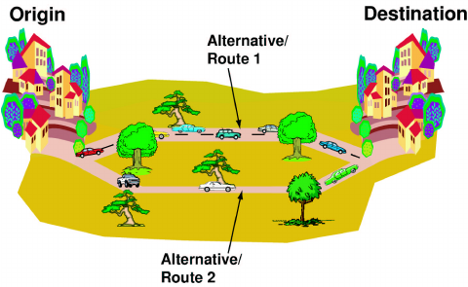
Defining accessibility
43m km² - around 1000 times the size of the Netherlands
There are many definitions in the literature. The most appropriate one here is:
“The extent to which land-use and transport systems enable individuals to reach activities or destinations by means of a transport mode(s).”^{[2]}
This definition accounts for location AND the inequality inferred by distance to locations since not all locations equal.
Accessibility can be a good indicator of the spatial structure of inequalities.
It is well suited to measurement in GIS^{[3]}.
2 Geurs, K. T. & van Wee, B. Accessibility evaluation of land-use and transport strategies: Review and research directions. Journal of Transport Geography (2004). doi:10.1016/j.jtrangeo.2003.10.005
3 Deichmann, U. Accessibility indicators in GIS (Department for Economic and Social Information and Policy Analysis, United Nations Statistics Division, 1997)

Slide 5
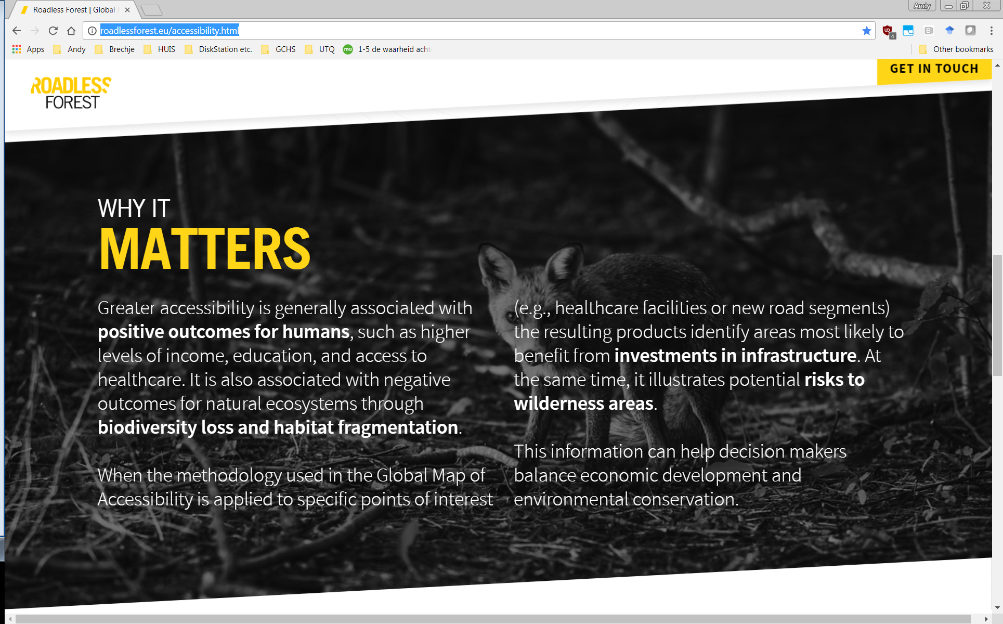
Accessibility, inequality and development
43m km² - around 1000 times the size of the Netherlands
Inequalities in access are important for rural economic development. High access to opportunities and resources is a good thing. They are also important for natural resource management, where high access can lead to over exploitation and degradation
Extracted from http://roadlessforest.eu/accessibility.html

Slide 6
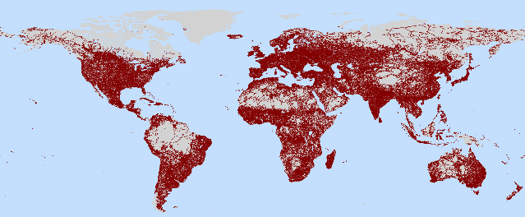
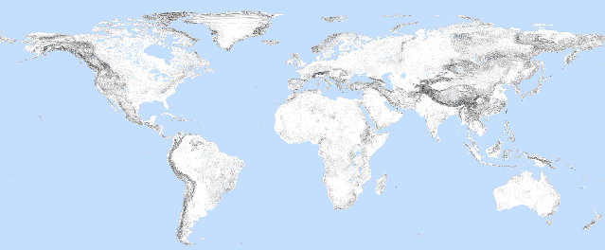
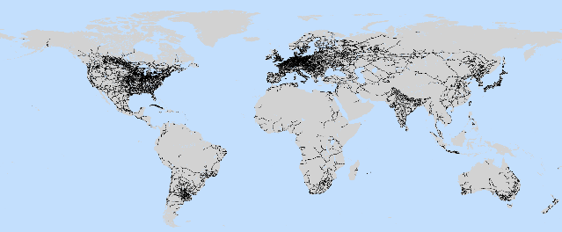
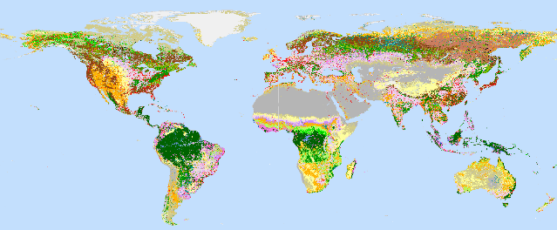
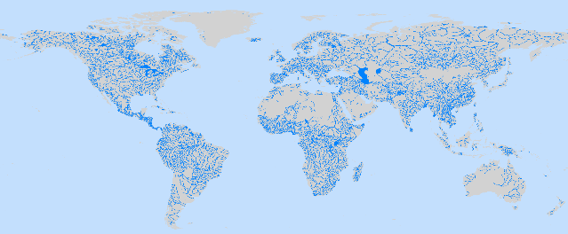
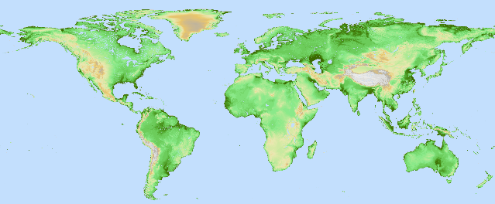
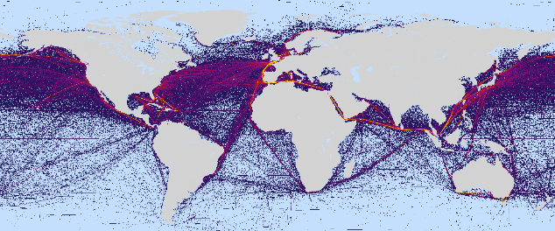
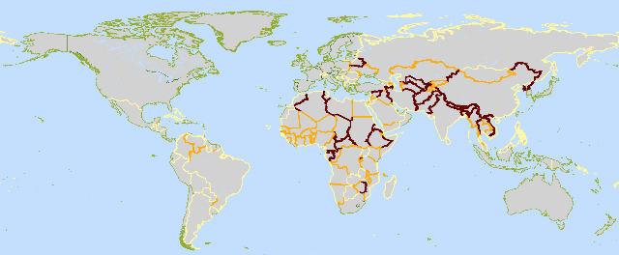
Mapping accessibility at the global level
In 2008, the World Bank asked me to estimate how many people lived within one hour of a city for the year 2000.
We wanted to estimate the number of people with access to the economic opportunities in cities.
I used global datasets on city locations and travel time factors.
I made a workflow to combine layers into a cost surface and estimated the accumulated travel time across that surface
Roads
Slope
Railroads
Land cover
Navigable waterbodies:
Elevation
Shipping lanes
Borders
https://openknowledge.worldbank.org/handle/10986/5991
Uchida and Nelson (2008) Agglomeration Index: Towards a New Measure of Urban Concentration. Background report for the 2009 World Development Report
Notes:
http://forobs.jrc.ec.europa.eu/products/gam/

Slide 7
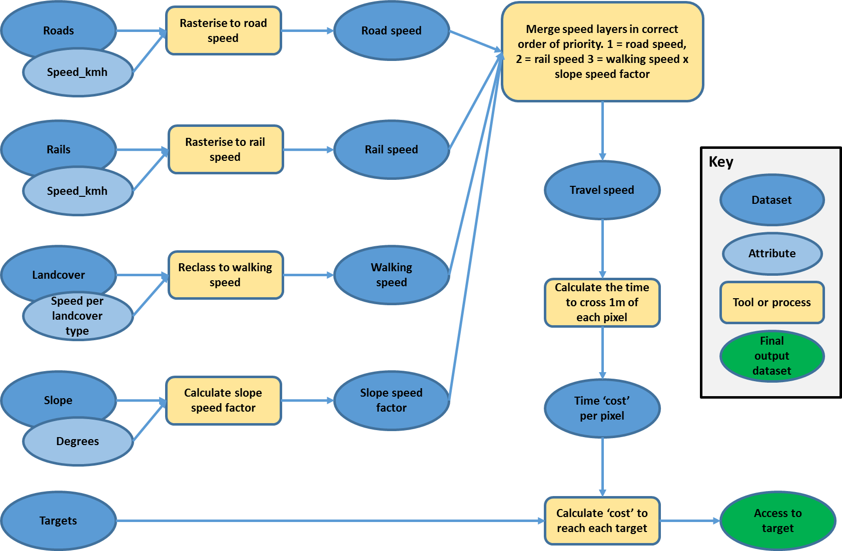
Workflow

Slide 8
Mapping accessibility at the global level
I then thought “what about the accessibility in other areas beyond 1 hour?”
The same workflow could be used but I relaxed the 1 hour condition on the accumulated cost function so that it would calculate the time from any location on the world’s surface to the nearest city.
I had to make some unhappy compromises with the projection. ArcGIS did not use great circle distances and no projection is equidistant from all locations. Also there was no “wrap around” to deal with travel across the international date line.
http://forobs.jrc.ec.europa.eu/products/gam/
Uchida and Nelson (2008) Agglomeration Index: Towards a New Measure of Urban Concentration. Background report for the 2009 World Development Report
Notes:
http://forobs.jrc.ec.europa.eu/products/gam/

Slide 9
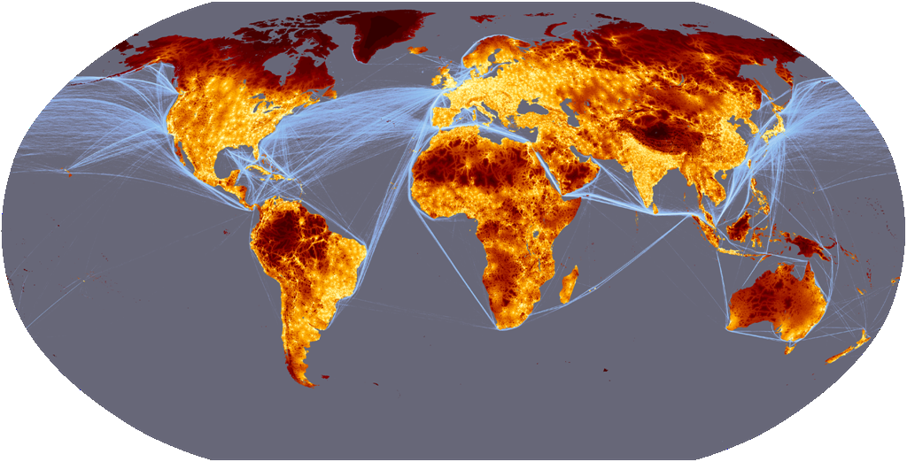

Travel time to major cities in the year 2000 (and shipping lanes)
forobs.jrc.ec.europa.eu/products/gam
Hours and days to the nearest city
0 1 2 3 4 6 8 12 18 24 36 2d 4d 5d 10d
Notes:
http://forobs.jrc.ec.europa.eu/products/gam/

Slide 10
It was a popular dataset
People started using it (~300 cites) for a range of applications & research questions
Access to new trading routes in the Arctic circle
Access to economic opportunities
Access to food markets in the horn of Africa
Access to energy (incorporating other layers of information)
Access to healthcare, education facilities
Where is the remotest place on earth?
Remoteness as a factor in deforestation and protected area effectiveness
Researchers were using it to look at economic and land use decisions/investments.
Having / not having access seemed important for rural development from both a local and global perspective.

Slide 11
How open were the data and workflows?
 | 2000 map
Input data | Open License and static
Processing | ESRI
Modelling | ESRI
Output data | Open License and static
Notes:
http://forobs.jrc.ec.europa.eu/products/gam/

Slide 12
Why make a new map for 2015?
There were four main reasons
Data
It was based on outdated information, from year 2000 or even earlier
Huge improvements in (mostly) open access information for mapping access
Technology
New possibilities for building and validating the map
New cost distance models based on true distance (no compromising projections)
New possibilities for anyone to run the models – move to more open workflows
Interest/need
Used in conservation, food security, trade and population health studies
2015 was a good time to benchmark the SDG agenda of “leave no one behind”
Funding & collaboration
Google Earth Engine Research Award in 2016 to the Oxford University team
Oxford, JRC, ITC, Google, Vizzuality and others.

Slide 13
Technology: Least cost path calculation for raster data
The first step of gdistance is to create a transition matrix from a raster.
Each cell in the raster corresponds to one row and column in the transition matrix
 | To
From | 1 | 2 | 3 | 4 | 5 | 6 | 7 | 8 | 9
 | 2
 | 3
 | 4
 | 5
 | 6
 | 7
 | 8
 | 9
1 | 2 | 3
4 | 5 | 6
7 | 8 | 9

Slide 14
Technology: Least cost path calculation for raster data
The first step of gdistance is to create a transition matrix from a raster.
Each cell in the raster corresponds to one row and column in the transition matrix
 | To
From
1 | 2 | 3
4 | 5 | 6
7 | 8 | 9

Slide 15
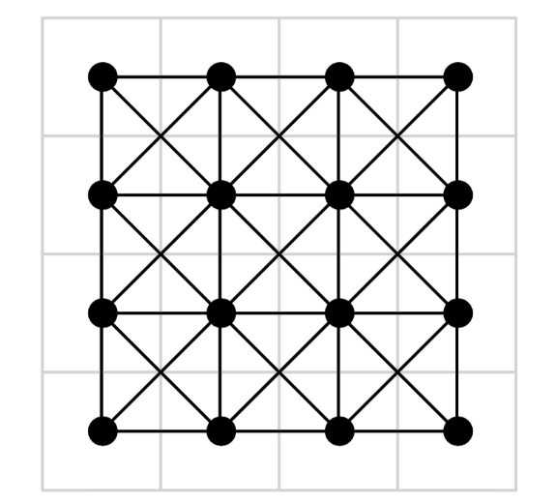
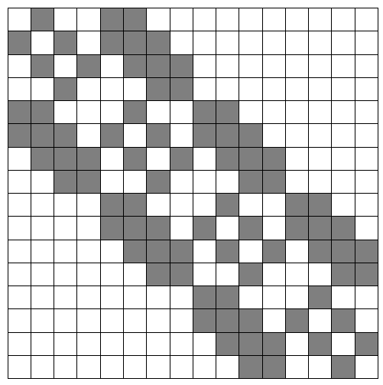
Technology: Least cost path calculation for raster data
This is how a graph that connects the eight direct neighbours translates into a transition matrix. The white spaces are zeros. Since we use sparse matrices, these zeros don’t occupy memory. The bigger the matrix, the bigger the proportion of white space (zeros)

Slide 16
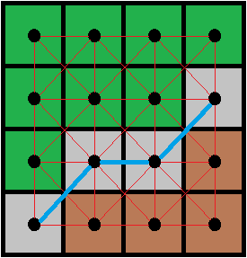
Technology: Least cost path calculation for raster data
Distances calculated between adjacent point centroids using great circle distance
Converts units from degrees to meters
As such all cell values (costs) are rates per meter
8-cell (queen) or 4-cell (rook) connections
We used 8-cell

Slide 17
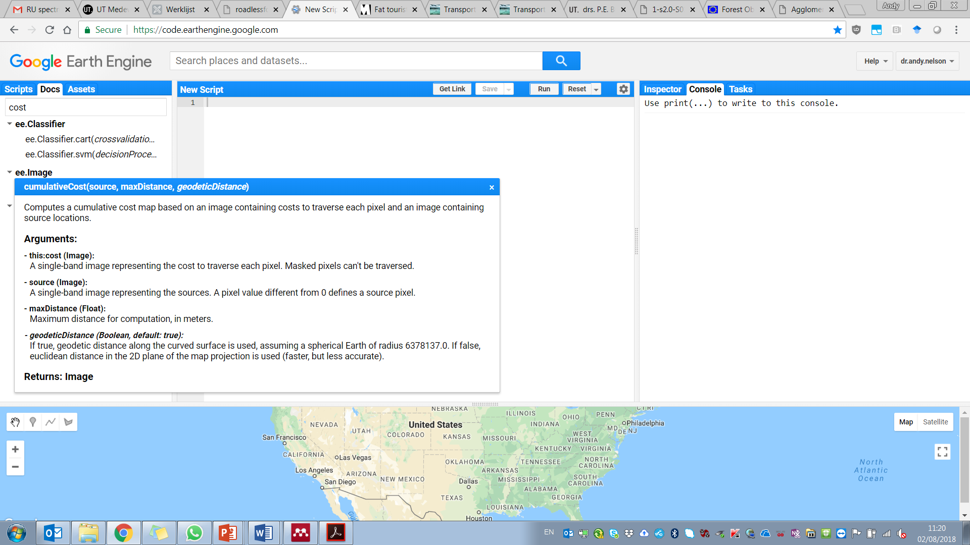
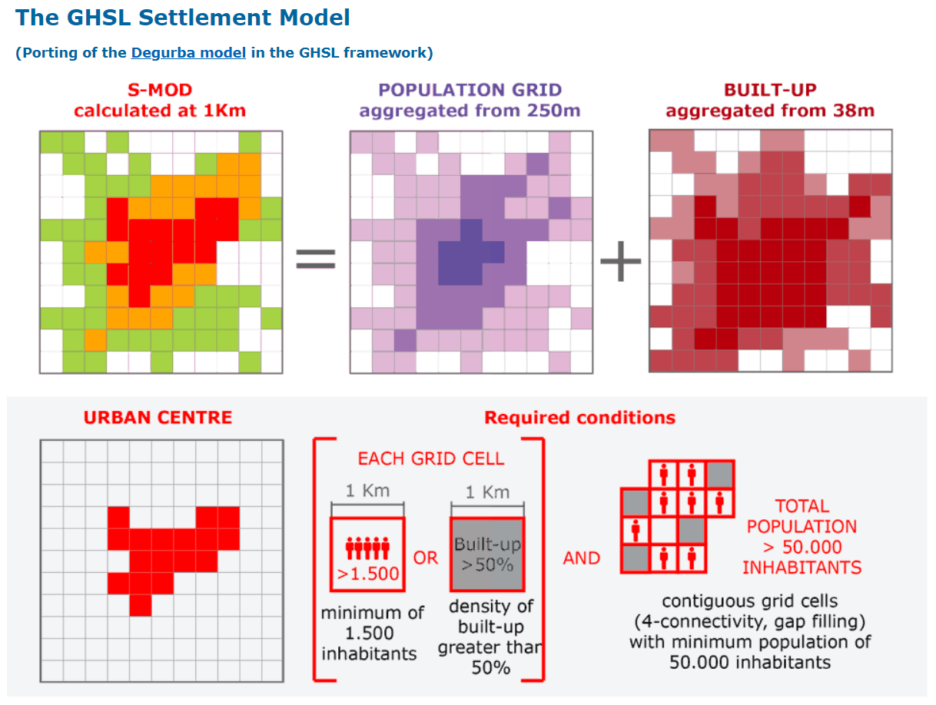
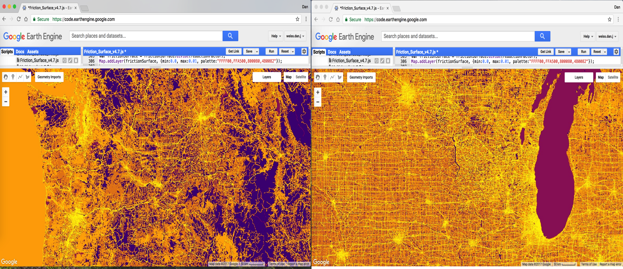
Technology: How the 2015 map was made?
Assemble geospatial datasets (primarily updated versions of those used in 2008)
Combine geospatial datasets into a ‘Friction Surface’
  With the exception of national borders, the fastest means of travel took precedence
  Friction measures how long it takes to move through each 1km pixel in minutes per metre
Acquire location information for cities
  For this we used JRC’s Global Human Settlement Layer for urban areas > 50,000 people
Apply the least-cost-path algorithm
  A new algorithm was prototyped in Google Earth Engine based on the gdistance R package
  We also used R / gdistance in some cases
Validate the model using Google travel API and GRUMP settlement points
  There was little/no validation of the year 2000 map
Notes:
This project represents the first time Open Street Map data and Google Roads data have been used together at the global scale
All but one of these layers improved considerably, as did the techniques for assigning costs associated with each

Slide 18
Data: Inputs for the 2015 friction surface and targets
Infrastructure/networks
  Roads and railroads (OSM and Google roads) – nearly 5 x more roads than the earlier map!
    Both of these were converted from lines (vector features) into raster features
  Associated lookup tables for assigning speeds
    Country-specific road type speeds as well as global defaults
Water
  Navigable rivers, lakes (JRC waterbodies data), and oceans (with unique movement rates)
Overland (on foot)
  Landcover (MODIS) with lookup table for movement rates for each type
  Topographic properties (slope angle and elevation from SRTM)
Political
  National borders with a fixed crossing-time penalty
Cities/Urban agglomerations
  Global Human Settlement Layer from JRC, 60% more locations than in year 2000

Slide 19
Technology: Creating the map
Mosaic tiles from Earth Engine and R
  28 tiles required for the global map (21 in Earth Engine and 7 in R)
  Full production runs take ~10 days using a single server for the R work (this is the rate limiting step due to RAM)
Where Earth Engine was game changing
  Densely populated areas such as eastern Asia and Europe
Where we needed R
  High latitudes (>~55 degrees) including some overlap
    Pixels in overlapping areas matched across platforms
  International Date Line
  Very remote islands beyond the Earth Engine search threshold limit

Slide 20
Caveats
Restricted to surface travel only (no air travel)
  This is okay since surface travel represents most forms of person-resource interactions
Does not account for temporal changes in access
  Seasonal flooding or differences between wet and dry season access
  Public transit scheduling, you are better off with Google or Waze ☺
  Rush-hour traffic, see above
Ignores characteristics of travelers
  Travel time depends on the economically available mode of transport
Isotropic friction surface
  Cost/time is the same in both directions of travel across the network

Slide 21
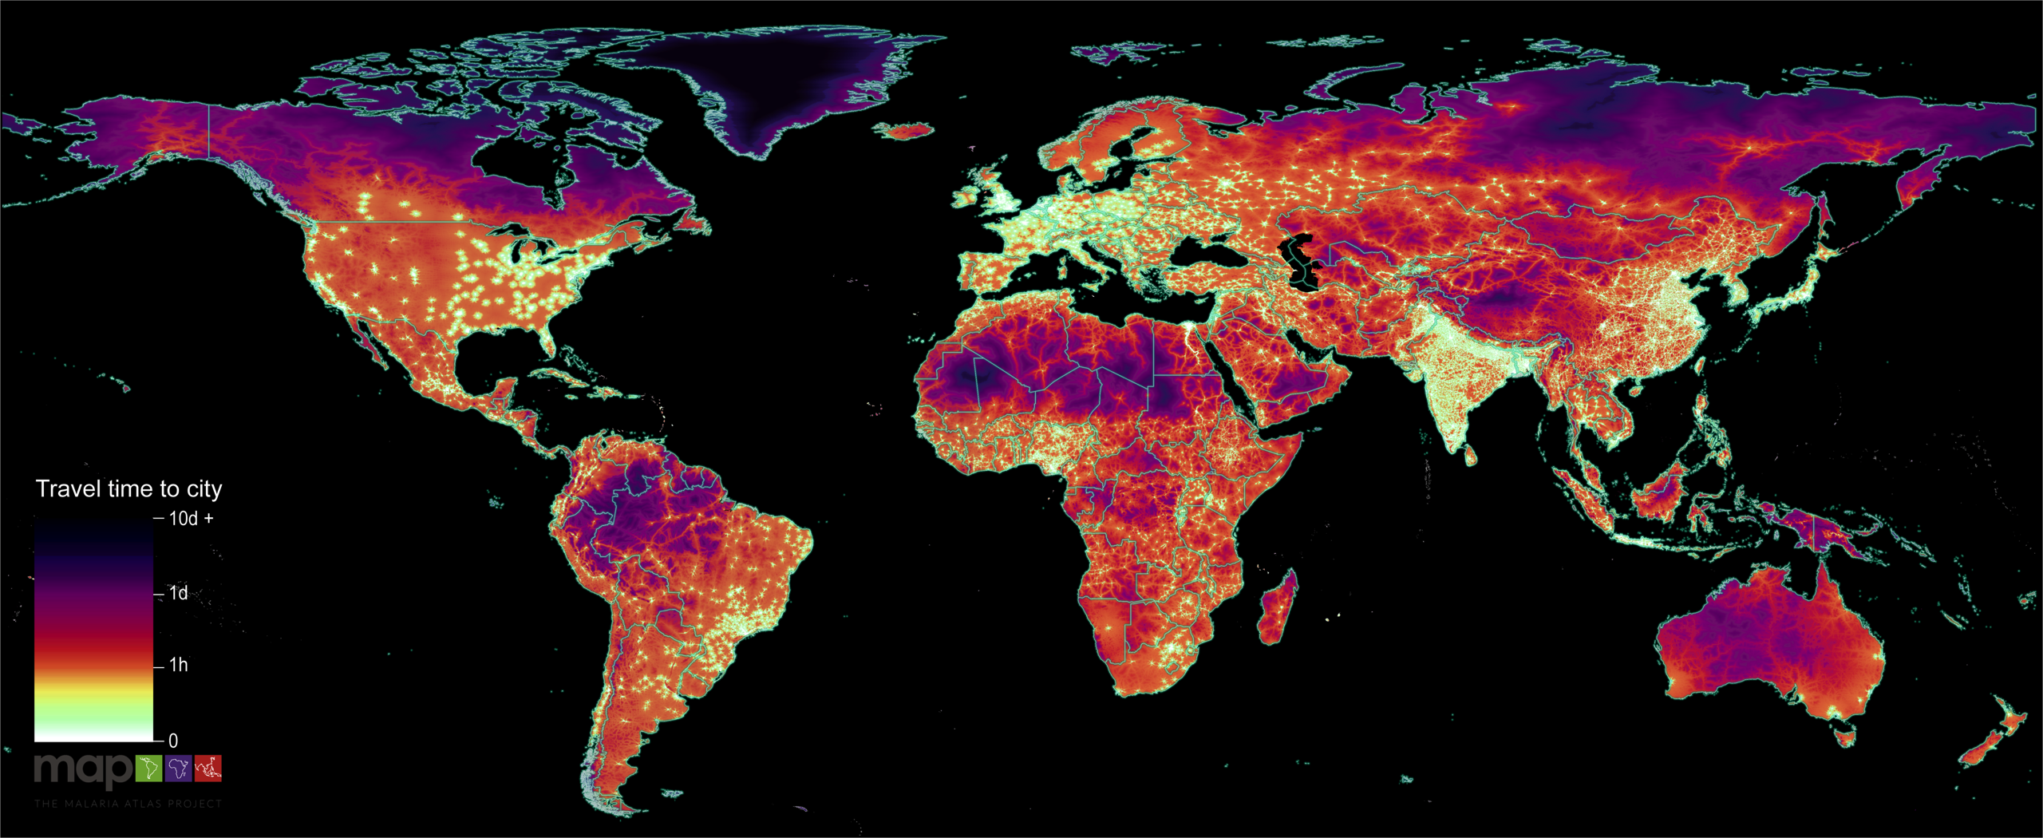
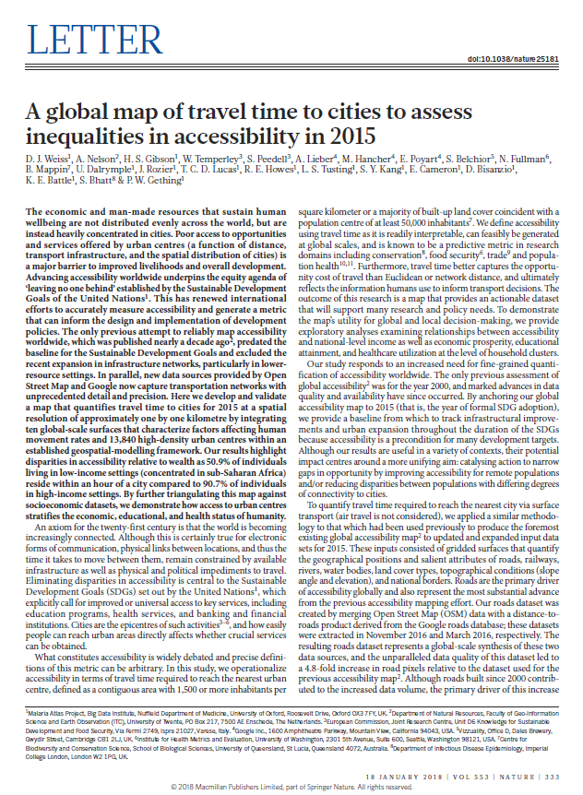
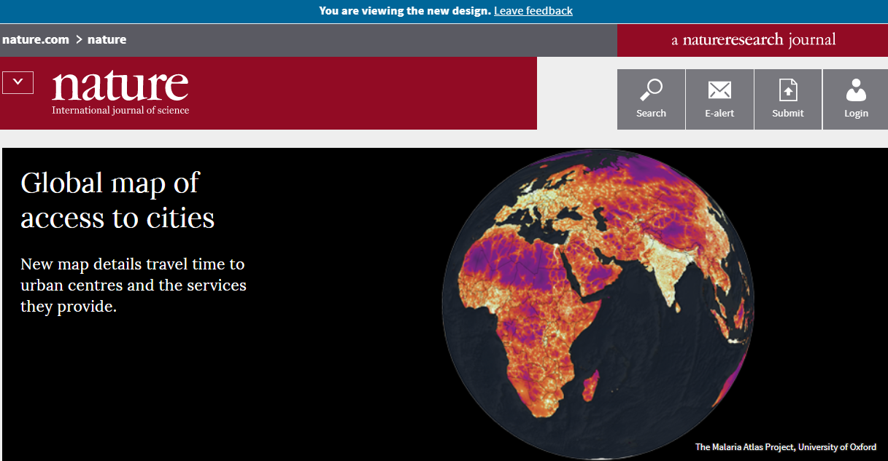
Travel time to major cities in the year 2015
Article published in Nature, 2018. All tools and data made available under a Creative Commons licence.
A global map of travel time to cities to assess inequalities in accessibility in 2015. Weiss, D. , Nelson, A. D. , Gibson, H. S. , Temperley, W. , Peedell, S. , Lieber, A. , Hancher, M. , Poyart, E. , Belchior, S. , Fullman, N. , Mappin, B. , Dalrymple, U. , Rozier, J. , Lucas, T. C. D. , Howes, R. E. , Tusting, L. S. , Kang, . S. Y. , Cameron, E. , Bisanzio, D. , Battle, K. E. & 2 others 18 Jan 2018 In : Nature. 553, 7688, p. 333-336 4 p.

Slide 22
Validating the map – are the travel times realistic?
The times are meant to be relative rather than exact, but we used the Google driving directions API and a global gazetteer of place names to build a list of over 50,000 locations where we could compare travel time estimates to the nearest city.
The validation results were encouraging, with an R² of 0.66 and a mean absolute error of 21 minutes. The major differences were concentrated in China where we relied on OSM roads rather than a combination of Google and OSM roads.
Could drop this slide, it is not essential
If we keep it - any graphics to add here?

Slide 23
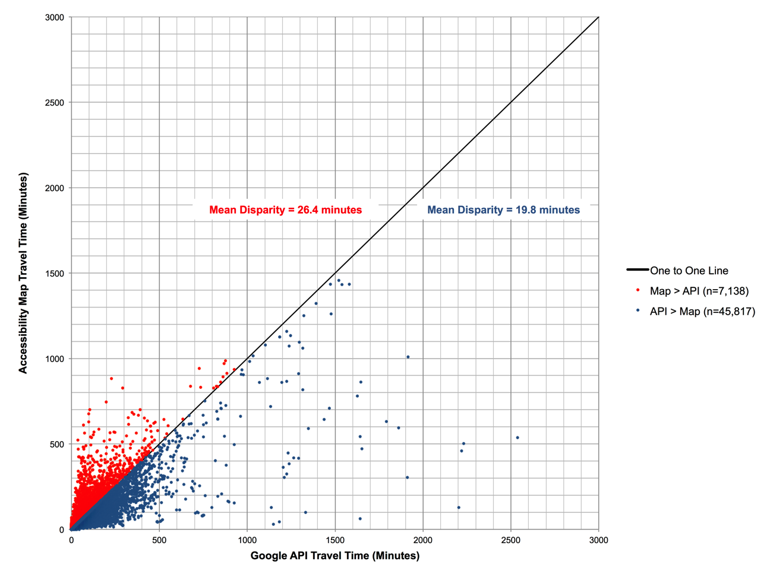
Validation
Linking non-city points in the GRUMP settlements layer to its closest city
Query the Google Maps Driving Directions API to extract travel times
Direction of the disparity was also informative
  For most of the world the MAP was faster than the API
  Exception was China, where we could not get Google Roads data (which highlights the importance of both roads layers)
Notes:
Over 50k point pairs remained
I could go much deeper here

Slide 24
Relevance for rural development - global
In high income countries, 90% of people live within 1 hour of a city.
In low income, only 50% do

Slide 25
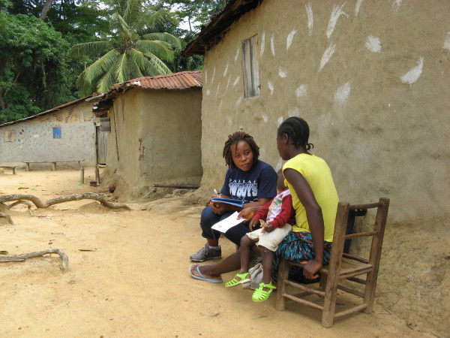


Relevance for rural development - local
For subnational analysis we utilized surveys collected by the Demographic and Health Surveys (DHS) program.
We used 66,768 household clusters, from 122 unique surveys spanning 52 countries, which were aggregated from nearly 1.77 million surveyed households to look at the relationships between access and rural wealth, health and education.
Credit: Joanna Lowell, The DHS Program
Photo: UNFPA/ Emma Powan

Slide 26
Relevance for rural development - local
Better access correlates with better rural livelihoods
https://dhsprogram.com/

Slide 27
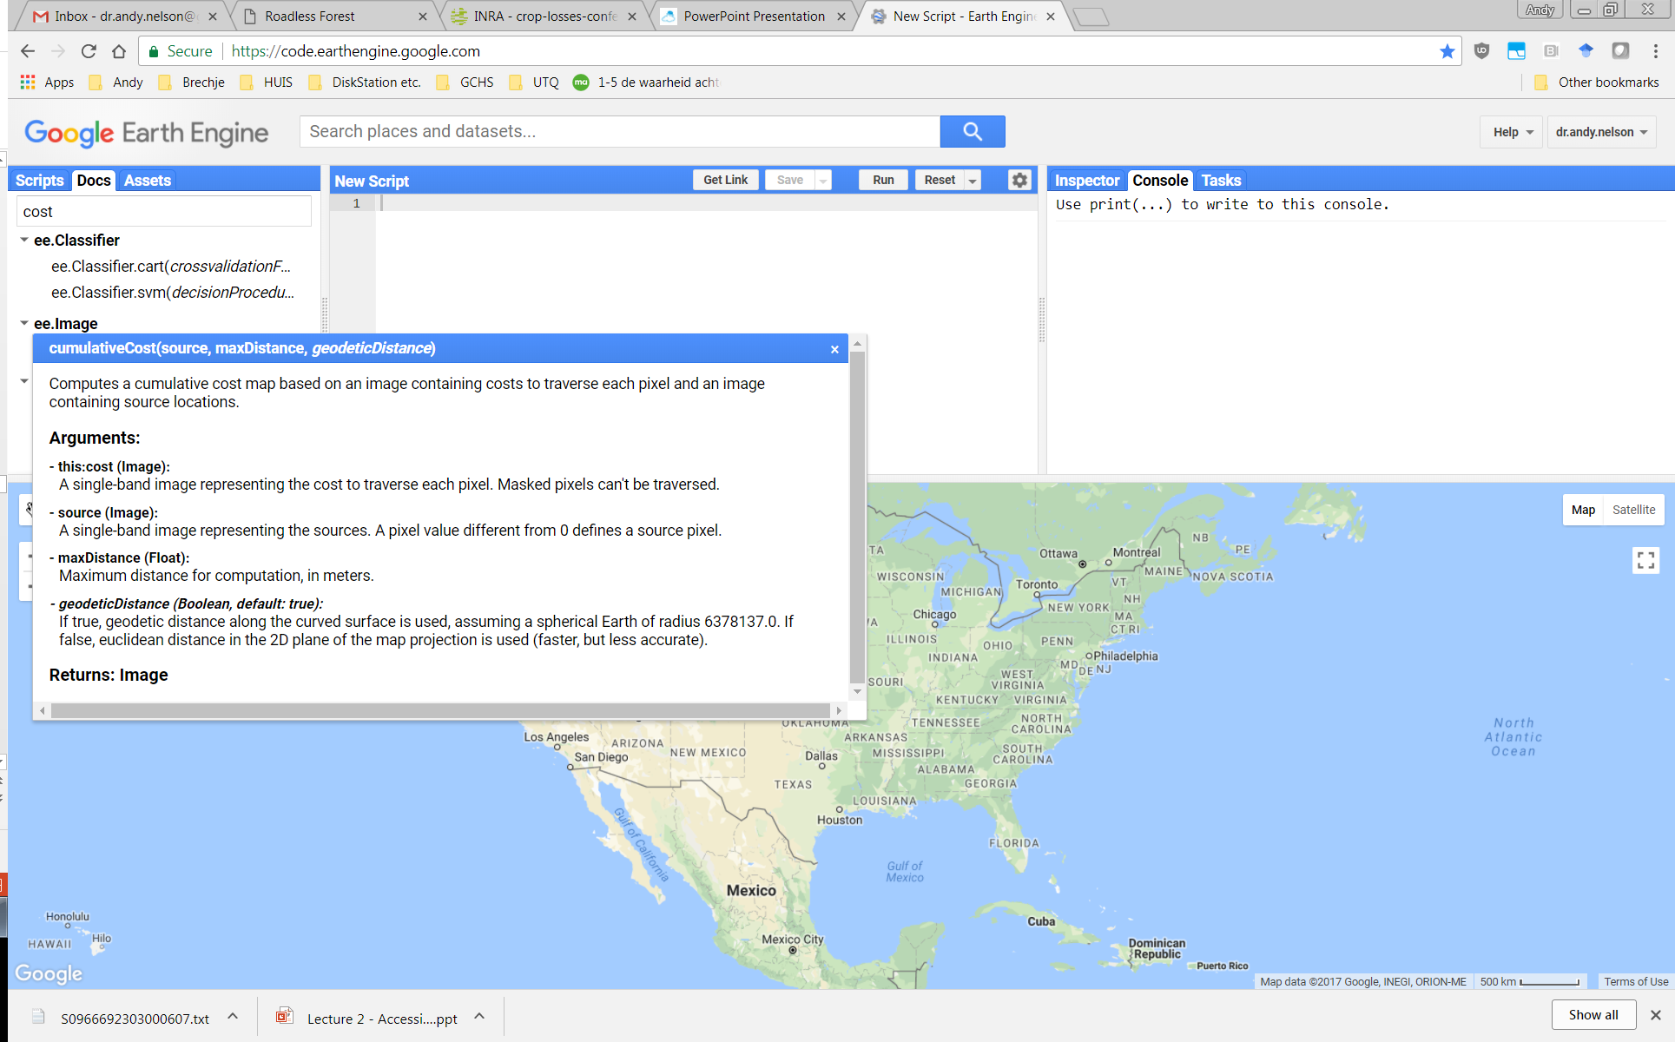
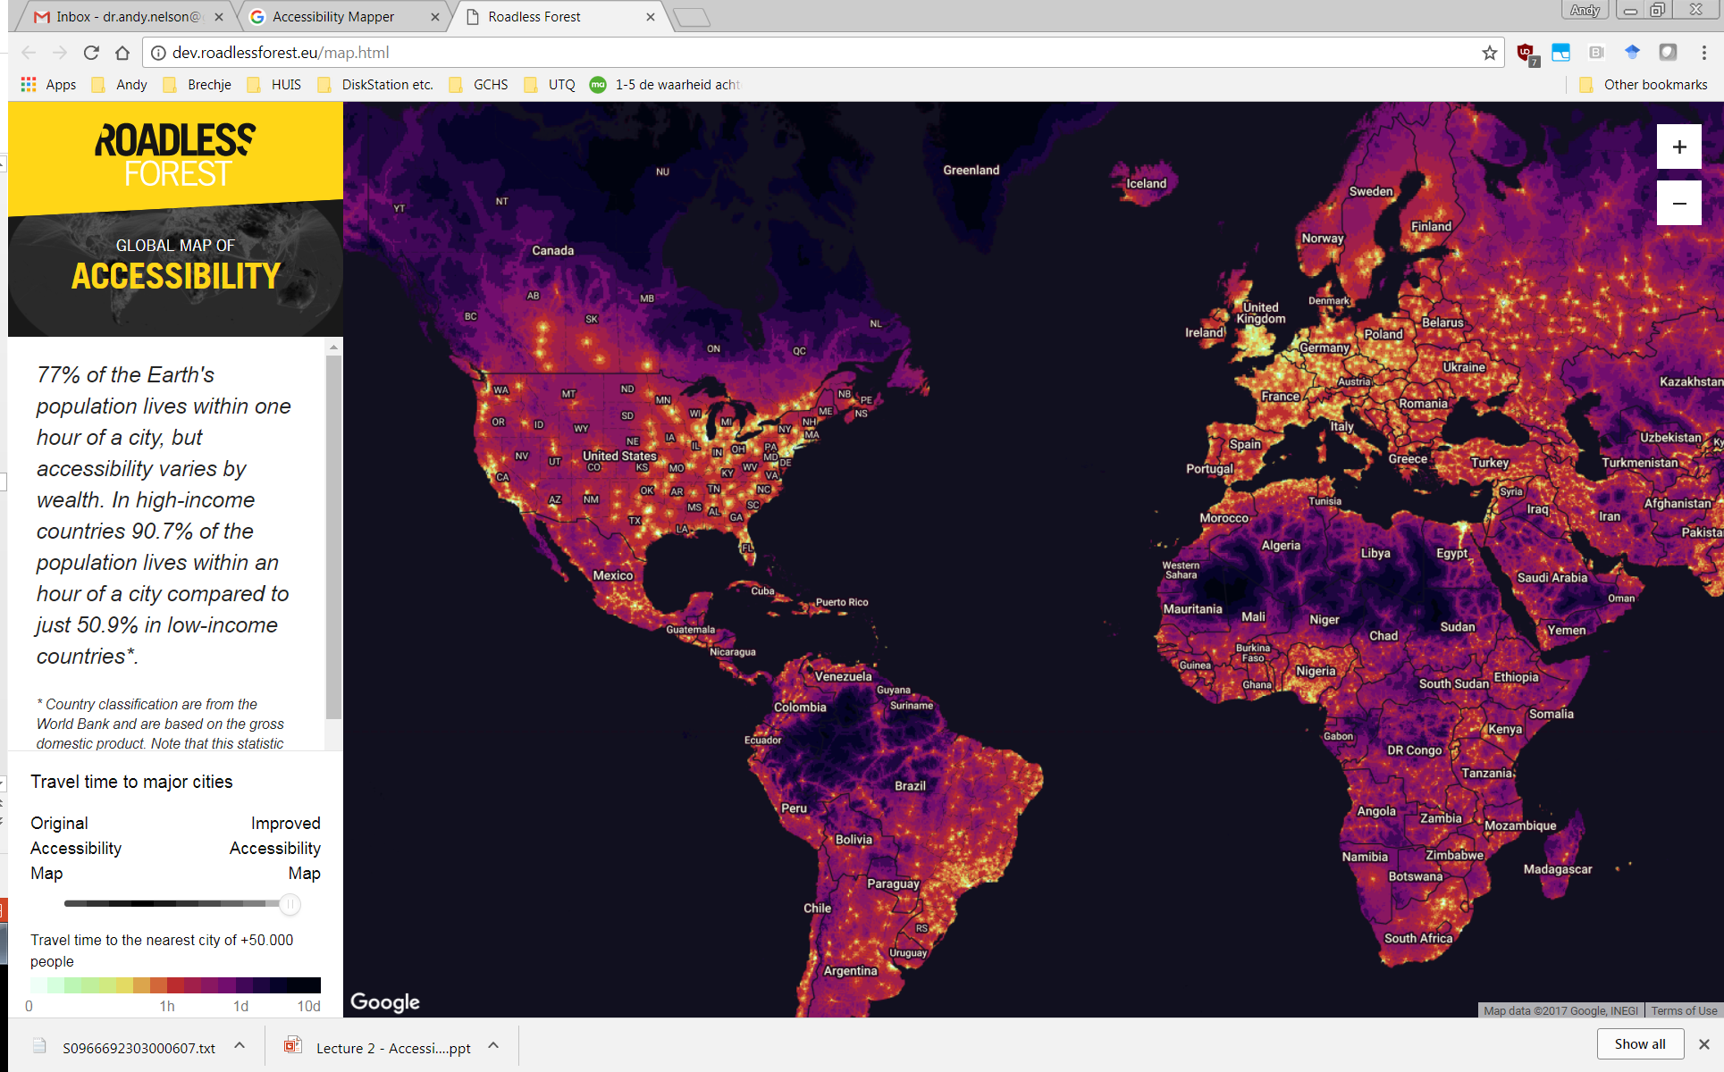
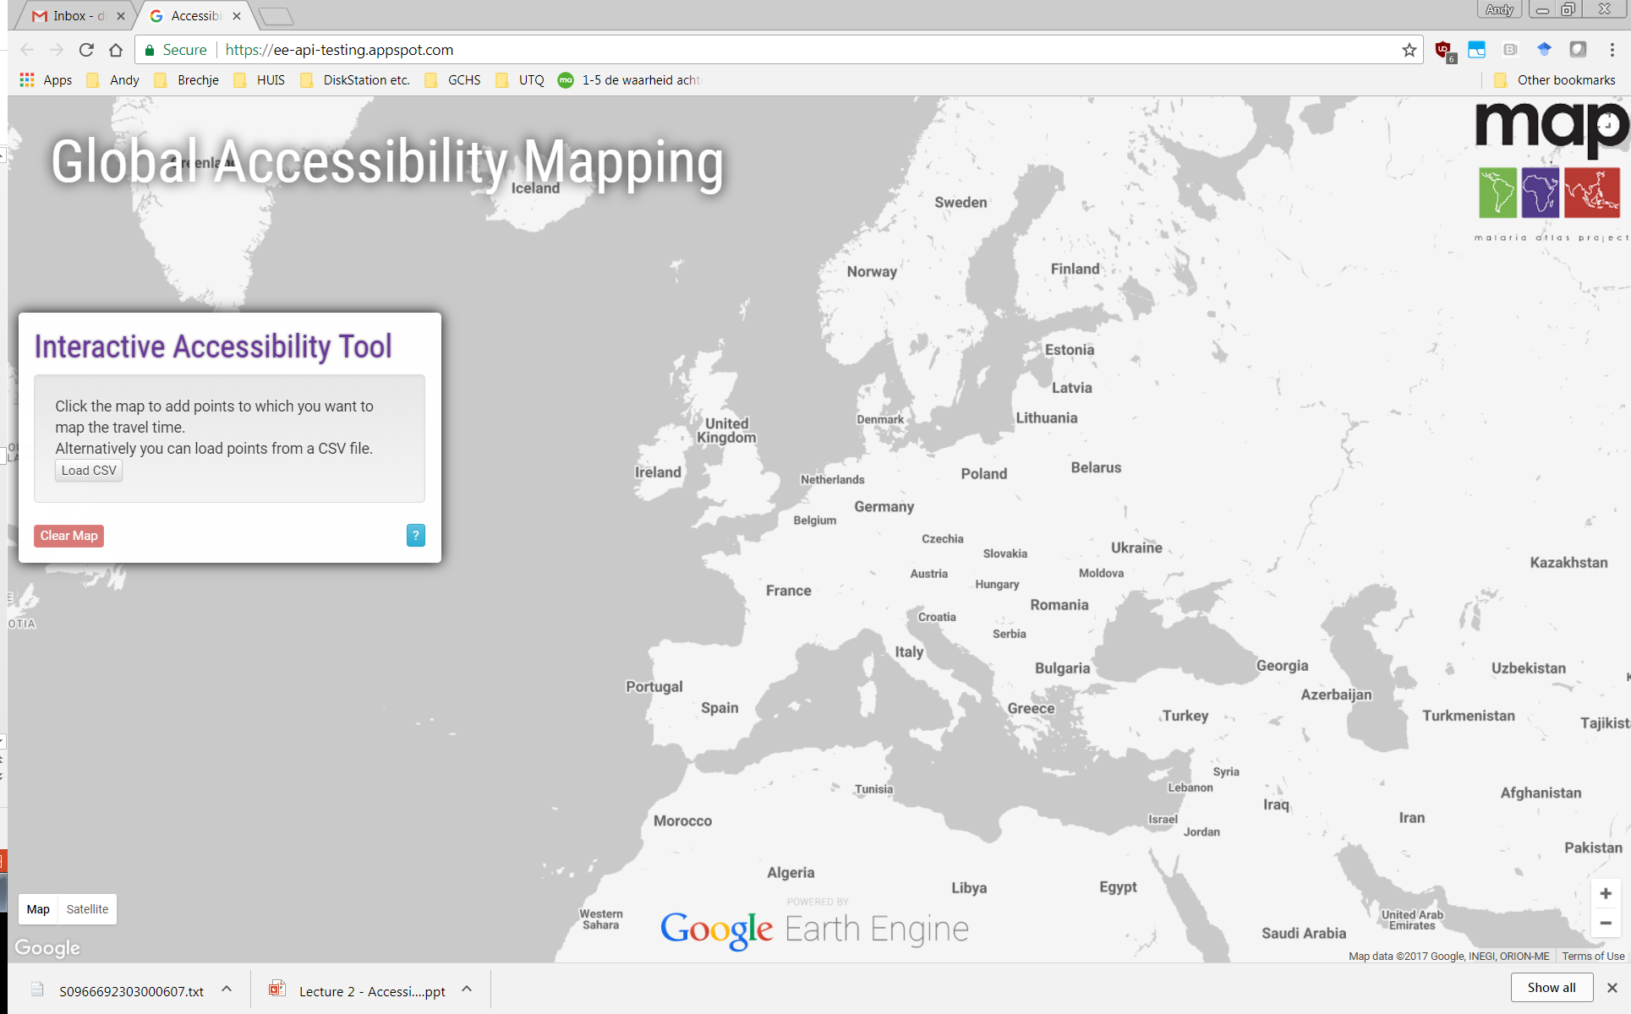
How to use the data and models
The CumulativeCost function is available in GEE.
The friction and travel time datasets are also in GEE.
The layers and tools are available outside GEE as GEOTIFFS under a CC Licence.

Slide 28
Better, but still not completely free and open
 | 2000 map | 2015 map
Input data | Open License and static | Mostly open, mostly static
Processing | ESRI | Google Earth Engine (GEE)
Modelling | ESRI | GEE &R
Output data | Open License and static | Open License and static

Slide 29
Workflow

Slide 30
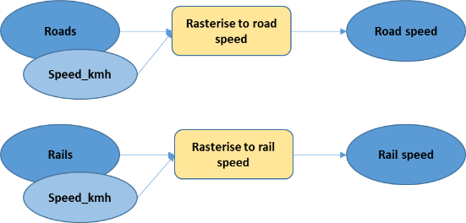
Parts of the workflow in R
# libraries, gdistance, which loads raster and igraph
library(gdistance)
# Load data layers and rasterise if needed
# Read the OSM roads shapefile into an object called road_shp
road_shp <- readOGR(dsn="inputs\\roads.shp")
# Read the slope geotiff into an object called slope
slope <- raster("inputs\\slopes.tif")
# Urban centers or targets
targets <- readOGR("inputs\\urban50k.shp")
# rasterise OSM roads using the SPEED_KMH. Use the maximum speed in cases where
# two or more roads exist in one pixel.
road_spd <- rasterize(x=road_shp, y=road_spd, field="SPEED_KMH", fun=max)

Slide 31

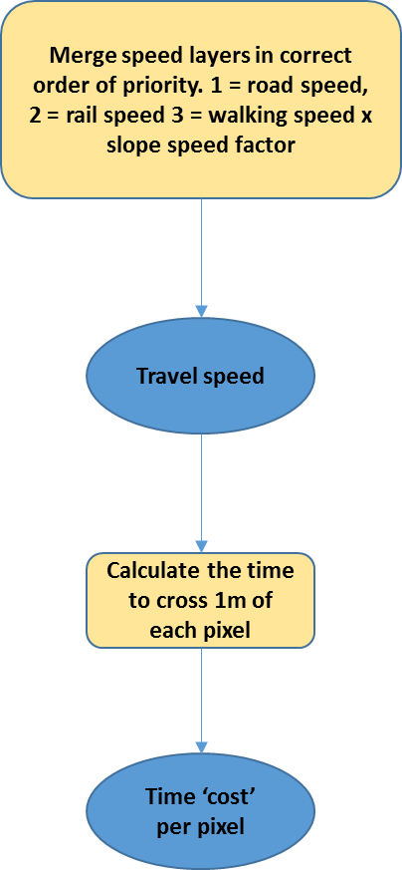
Parts of the workflow in R
# Slope
# Tobler's walking speed is given by W = 6e^-3.5|tan(slope)+0.05|
slp_w <- 6 * exp(-3.5 * abs(tan(slope*pi/180) + 0.05))
# divide by base speed of 5km/hr to get speed factor and write that to a file
base_spd <- 5
wlk_spd <- slp_w/base_spd
# Merge the speed components
# road takes priority over rail and rail takes priority over walking
merge_spd <- merge(road_spd, rail_spd, slp_spd)
# convert speed in km per hr to travel time in minutes per metre
merge_mins <- 1.0 / (merge_spd * 1000 / 60.0 )

Slide 32
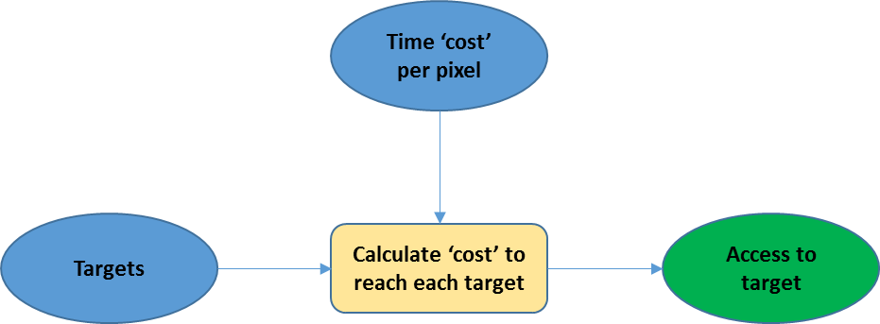
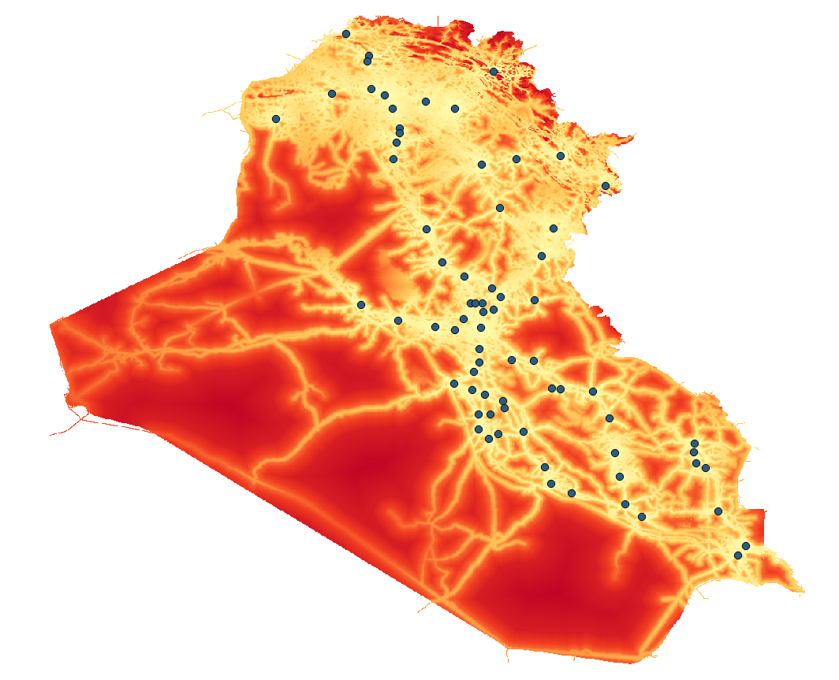
Parts of the workflow in R
# Travel time output
# Make the graph for 8 directions using 1/mean(merge_mins) as conductance value
# between neighbouring cells
T <- transition(merge_mins, function(x) 1/mean(x), 8)
# geo-corrected version of the graph, divide the conductance by the real distance between pixels.
T.GC <- geoCorrection(T)
# accumulated cost calculation using geo-corrected graph and the target points.
access_mins <- accCost(T.GC, targets)

Slide 33
Almost there…
 | 2000 map | 2015 map
Input data | Open License and static | Mostly open, mostly static
Processing | ESRI | R
Modelling | ESRI | R
Output data | Open License and static | Open License and static
Notes:
http://forobs.jrc.ec.europa.eu/products/gam/

Slide 34
Global processing of 1km spatial data in R is tricky
The main obstacle is generating the transition matrices of connectivity needed to calculate the accumulated cost between locations
T<-transition(merge_mins, function(x) 1/mean(x),8)
These matrices are limited to around 2Gb in the current implementation, about enough for a 40 x 40 degree tile. And each one requires around 200Gb of RAM.
But, these tiles need to have a massive (20 degree) overlap to ensure no edge effects from accumulated costs between distant points.
Also need to take care of travel across the international date line.
This results in around 40 overlapping tiles to process and requires a system with over 200Gb of RAM. Each matrix takes 4-6 hours to compute.

Slide 35
Towards new tools and metrics
The 2000 and 2015 access maps are a contribution to sustainable development research yet travel time is only one measure of access; others such as distance to roads, interaction potential and road density are also important.
More open and timely information related to sustainable development can be derived from the global transport network.
The means to obtain and process the data on a global scale and the tools to regularly analyse the network and generate metrics do not exist.
A need to (i) develop efficient, open-source processing chains and algorithms that can rapidly process vast global transport network data (OpenStreetMap); (ii) generate a range of access related metrics at high spatial resolution on a regular global grid, and; (iii) estimate uncertainty in the metrics.

Slide 36
More efficient tools to avoid memory issues
The transition matrix approach is very flexible. The algorithms in R, however, are generic and work in memory only (Dijkstra in igraph).
So – what can be done?
Implementation of a parallel version of the “pushbroom” algorithm for distance calculations with friction weights in gdistance.
Graph-based distance research (working with OpenStreetMap directly, for example) works with this data as being non-planar, and the cool thing would be to do this with raster data directly.
Make out-of-memory shortest path algorithms available in R. So-called "contraction hierarchies" would help to do this, as these allow processing in chunks.

Slide 37
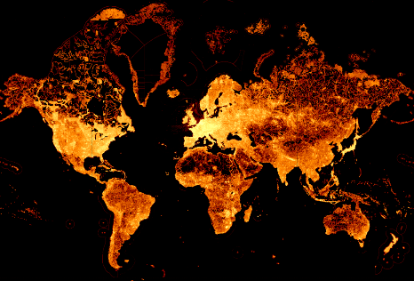
Regularly updated with current transport network data
Need a way to efficiently access OpenStreetMap transport networks in R.
https://tyrasd.github.io/osm-node-density/#2/16.5/389.2/latest,places

Slide 38
What sort of new metrics ?
road density,
distance to roads,
distance to cities,
access to protected areas,
access to cities or other locations where services/opportunities exist, and
accessibility potential of cities.
These can be linked to spatial data sets on the population or segments of the population to assess inequalities or pressures.

Slide 39
What are we aiming for?
New metrics for cost (friction) and access delivered on an annual basis.
Ability to make custom maps for new point features already by anyone.
Custom friction surfaces are also possible for things like new roads or alternative means of travel (e.g., we’ve made a ‘walking only’ version for non-motorized travel).
This would address a long-term scientific challenge by making a significant contribution to the relatively small number of high spatial resolution, global socio-economic datasets. These layers can be analysed alongside global datasets on climate, environment, demographics and poverty.

Slide 40
Free and open data and workflows for access mapping
 | 2000 map | 2015 map | Beyond
Input data | Open License and static | Mostly open, mostly static | Open License and dynamic
Processing | ESRI | R | R
Modelling | ESRI | R | R
Output data | Open License and static | Open License and static | Open License and dynamic
Notes:
http://forobs.jrc.ec.europa.eu/products/gam/

Slide 41
Further information
Data and workflows
map.ox.ac.uk/research-project/accessibility_to_cities
forobs.jrc.ec.europa.eu/products/gam
The gdistance package
cran.r-project.org/web/packages/gdistance/index.html
References
Weiss DJ., Nelson A., …, Gething PW. (2018). A global map of travel time to cities to assess inequalities in accessibility in 2015. Nature. doi:10.1038/nature25181
van Etten J (2017). R Package gdistance: Distances and Routes on Geographical Grids. Journal of Statistical Software 76(13) p1–21. doi:10.18637/jss.v076.i13

Slide 42

Mapping inequality in access to resources in R
Andy Nelson (ITC, U. Twente), Jacob van Etten (Bioversity International), Daniel Weiss (U. Oxford)
Interested in accessibility for your work?
Fill in this survey [tiny.cc/accmap] to request new global accessibility layers
a.nelson@utwente.nl
@Dr_Andy_Nelson
research.utwente.nl/en/persons/andy-nelson
Notes:
More equal access to the resources that sustain human well-being, such as education, employment and health services, underpins the equality agenda of 'leaving no one behind' established by the Sustainable Development Goals of the United Nations. Accessibility can be defined as the ability to interact with locations that offer economic and social opportunities; better access usually means better opportunities and better livelihood outcomes. The accessibility of a particular location can be quantified in several ways: equity (i.e. proximity based on distance or travel time); coverage (i.e. the number of reachable resources per person), or; integration (i.e. the likelihood of interactions or the cost of transactions). Spatial modelling of accessibility uses the geographic location of the population in relation to target locations and the transport means and infrastructure to access those locations. This presentation discusses (i) recent work on mapping equity in access in R using the gdistance package, (ii) options for mapping other access indicators in R and (iii) the importance of good, up to date and easy to use transport network data for accessibility mapping.

